Slide 1
Film Recommendation Team02
Ray Zeng | Zhijie Xu | Swastik | Siddharth｜Aditya

Slide 2
Table of contents
01
02
03
04
05
06
Database
Git
Data Quality
CDC
Monitoring
ML

Slide 3
01
Database

Slide 4
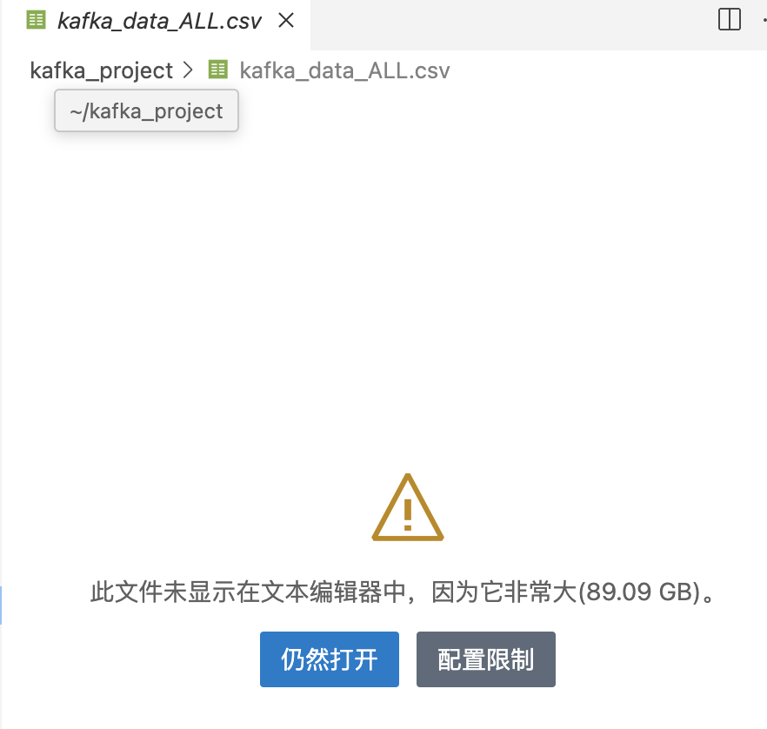
Three Databases In M1
CSV
MySQL
NoSQL
CSV files store raw data parsed from Kafka streams, offering a lightweight and portable format for quick data inspection and backup.
MySQL serves as the primary relational database for structured data, ensuring consistency and supporting efficient querying for recommendation system workflows.
MongoDB is used as a NoSQL database to store semi-structured data like detailed movie metadata and user interaction logs, supporting flexible data retrieval for advanced analytics.

Slide 5
Two Databases In M2
CSV
MySQL
Backup PLAN Size down to 1.9GB
Optimized data storage by partitioning and indexing rating and minute data.

Slide 6
Two Databases In M3
CSV
MySQL
Recovery data by CSV
Change Schema for time series

Slide 7
02
Git

Slide 8
Git it done!
M1
M2
Use the naming format milestone-<number>-<part_of_the_task>
Avoid deleting merged branches until graded
Require two reviews before code is pushed to production.
Reasonably cohesive commits and appropriate commit messages? ~150 commits!

Slide 9
03
Data Quality

Slide 10
Why so little Data? - Zhijie
Our data preprocessing strategies evolved significantly from Milestone 1 to Milestone 3 .
Key decisions included selecting appropriate keys for performing joins.
We developed approaches to handle random data being sent to the Kafka system.
We established methods to address missing values.
Quality testing for our data was implemented to ensure reliability.
Trade-offs were made to accommodate some poor-quality data at a very minimal level, which would not negatively impact the learning model.
After all that effort we did end up with movies called 02hxwroiv23rtufe and 02wjoysipyyucflqn0cyr5

Slide 11
04
CDC and Containerization

Slide 12
Change Data Capture
Enhance user engagement through timely movie suggestions
Challenges:
Delayed Processing : Batch systems lead to outdated recommendations.
Database Changes : Difficulty in capturing real-time updates.
Scalability : Need to manage vast user data and schema evolution.
Solution :
Debezium: Captures real-time changes and streams to Kafka.
Kafka : Facilitates efficient event streaming.
Apache Iceberg : Provides scalable long-term storage for historical data.

Slide 13

Docker, Kubernetes and the Art of Not Losing Your Mind
Late-night debugging taught us the importance of clear configurations.
Next Time: Start with better understanding of Kubernetes best practices.
Dive into tools early to avoid mid-project steep learning curves.
Gradual rollouts + robust monitoring = fewer gray hairs.

Slide 14
05
Monitoring

Slide 15
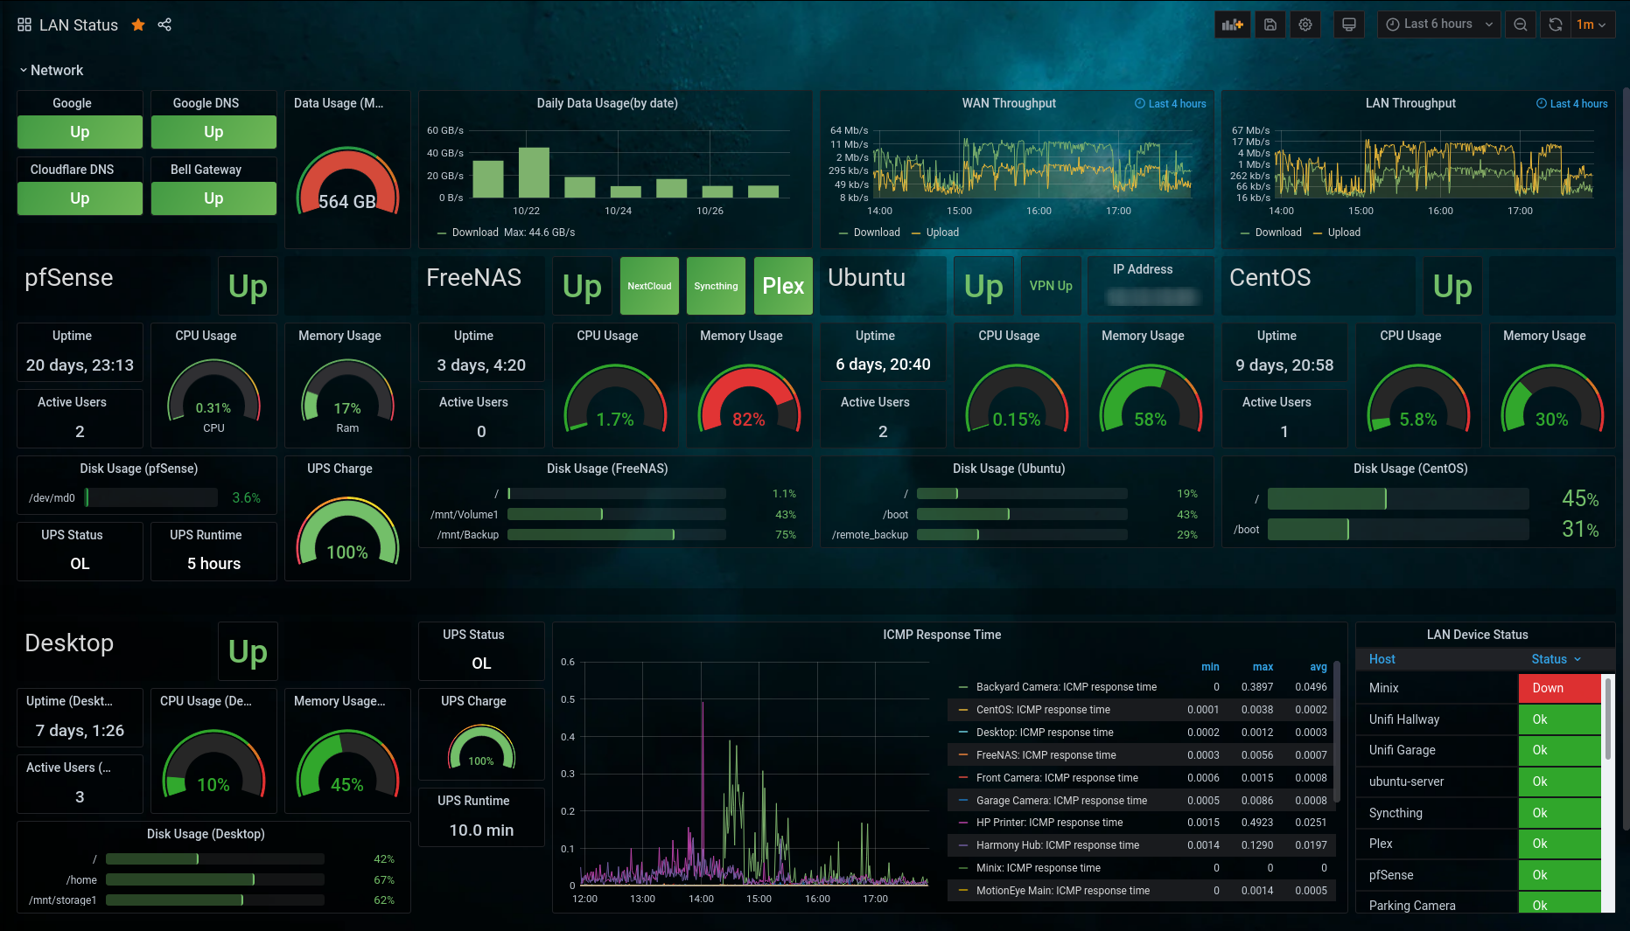
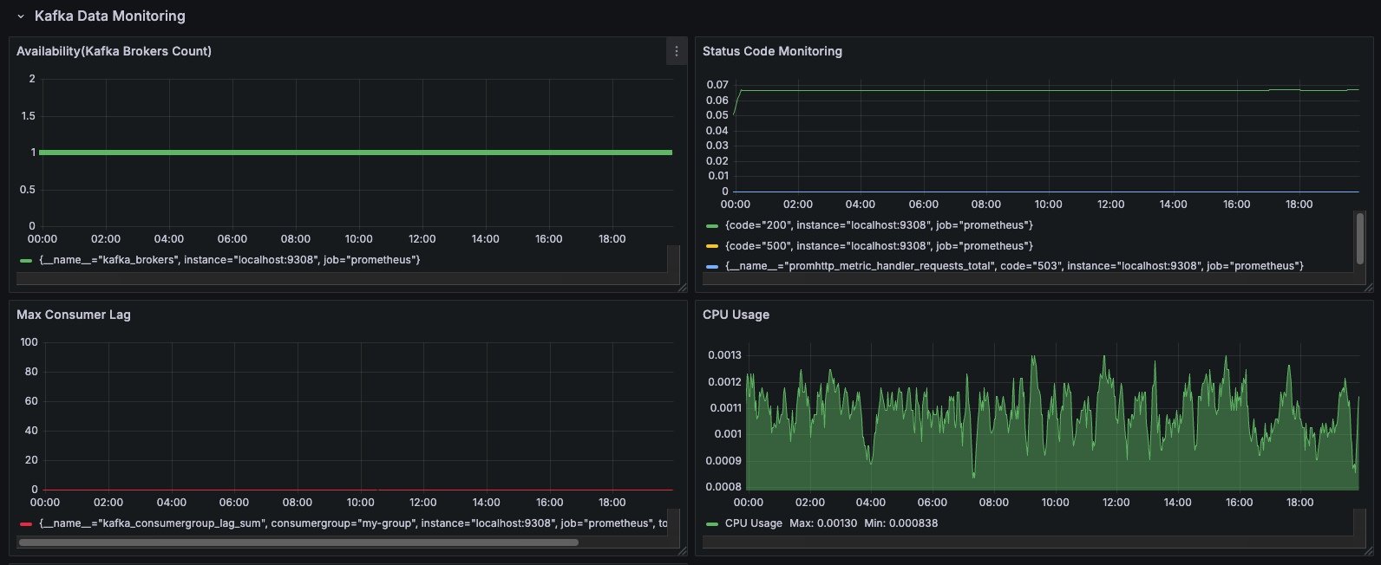
Grafana
What we wanted
What we had
Why? The amount and types of telemetry data we collected was limited(availability, online evaluation and request info) and if we had to do it again, we’d collect lot more types and volume of data

Slide 16
06
ML

Slide 17
Machine Learning Component
M1
M2
Explored different models: Random Forest, SVM, KNN, Neural Collaborative Filtering.
Taking a lot of time training the model due to the data size and the incompatible data feature.
Reflection: evaluate the model first, then design the data schema.
Changed model hyperparameter due to the change of data schema (IMDB) and the growth of data size.
Did not split in chronological order.
Reflection: need to take care of data property; otherwise, need to refactor the data pipeline.

Slide 18
Machine Learning Component
M3
Fully integrated with MLflow, need to integrate it with the online
Rewrite code into modules; improve code reusability.
Reflection: wisely design the ML system corresponding to the recourse we have

Slide 19
Final Takeaways
Pre-holiday crunch plans: Finish critical tasks early.
RACI framework (Responsible, Accountable, Consulted and Informed): Clearer roles, less confusion.
More retrospectives: Solve problems before they escalate.
Redundancy in tasks = vacation-proof progress.
Documentation is king for async communication.

